Slide 1
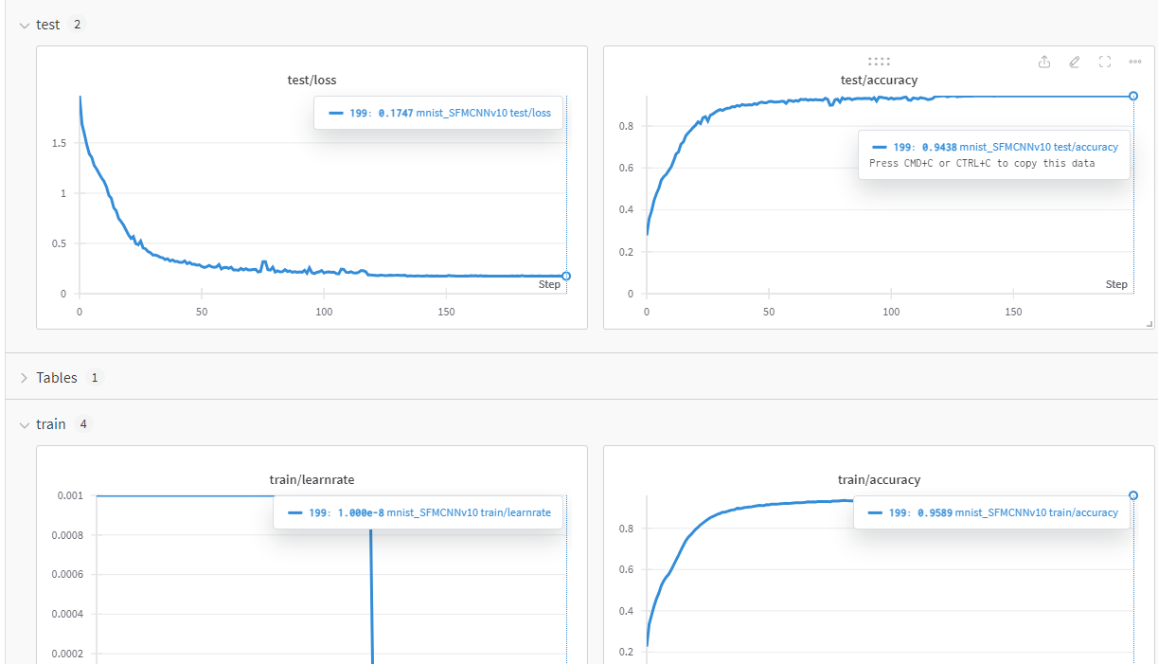
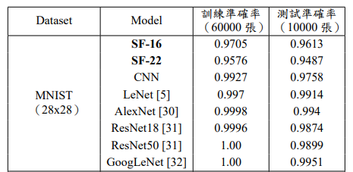
MNIST 驗證

Slide 2
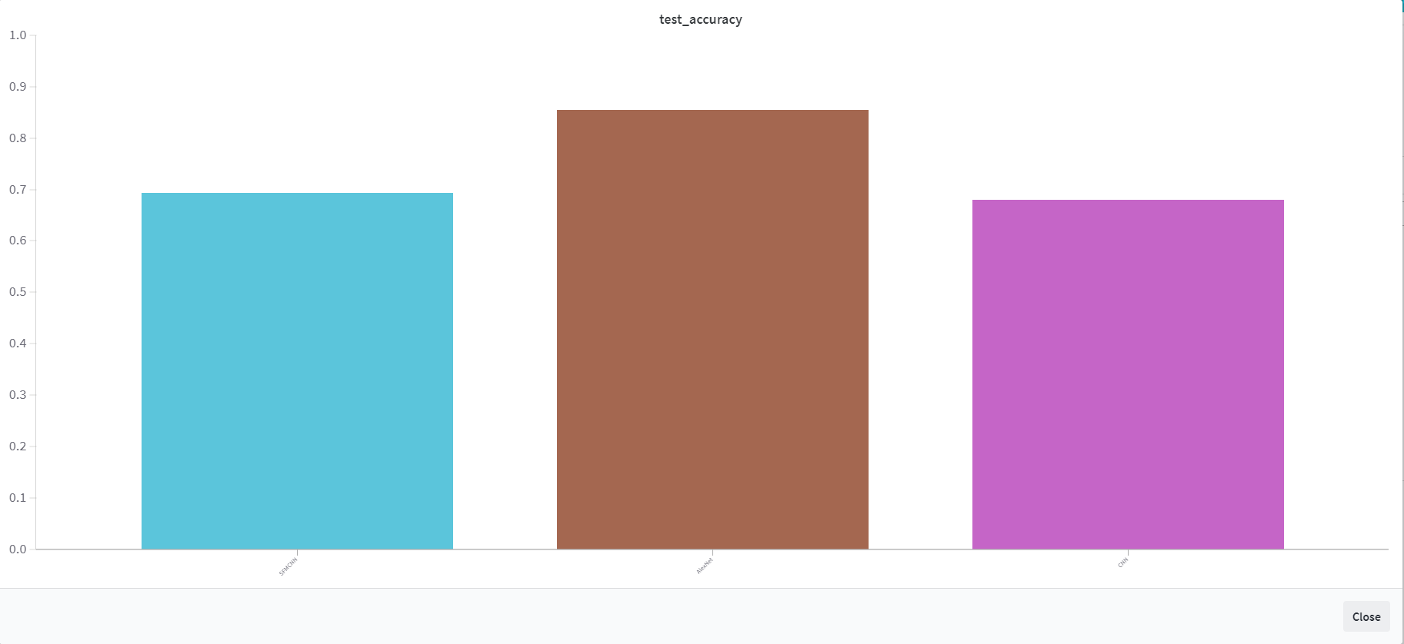
Model | SFMCNN | Simple CNN | AlexNet
Train_accuracy | 0.77 | 1.0 | 1.0
Test_accuracy | 0.6933 | 0.68 | 0.855

Slide 3
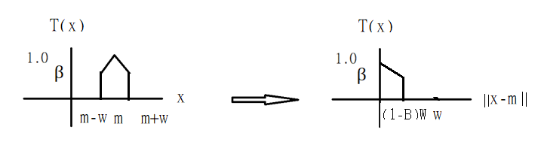

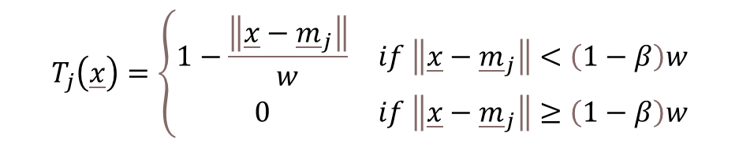
$$T_{j}\left(\underline{x}\right)=\left\{\begin{matrix}1−\frac{\left\|\underline{x}−{\underline{m}}_{j}\right\|}{w} & if \left\|\underline{x}−{\underline{m}}_{j}\right\|<\left(1−β\right)w \\ 0 & if \left\|\underline{x}−{\underline{m}}_{j}\right\|≥\left(1−β\right)w\end{matrix}\right.$$
z = (1 - β) * w and 0 <= z <= w
舉例:
想要保留一半的數據
取 之中位數當作z
If z > w then z = w

